Slide 1

Growth and development Overview
Third Stage
Dr. Moustafa Alshammari
Growth and Developments

Slide 2
Learning Objectives:
Mastery of content in this chapter will enable the student to:
Identify the importance of growth and development.
Describe and differentiate between growth and development.
Recognize and discuss the factors that influencing growth and development.
Describe the stages of development.

Slide 3
Growth and Development
Definitions:
Growth:
It is the increase in physical size of the
whole body or any of the parts of the body.
Because of cell division and synthesis of
proteins. It causes a quantitative change in
the child's body.
Growth can be measured accurately in
inches, centimeters, pounds or kilograms.

Slide 4
Development:
It refers to progressive increase in skills and capacity of functions.
It causes a qualitative change in the child’ functioning.
Development can be measured but its measurements are not so accurate as growth as it is measured through observation.

Slide 5
Maturation:
Literally, it means ripen.
It is described as ageing or an increase in child's competence and adaptability.
It is usually used to describe qualitative changes in a structure, i.e., the structure begins to function or to function at a higher level depending on the child's heredity.

Slide 6
Principles of growth and development:
Growth and development are continuous processes.
Each child has his own rate of growth and development.
Both growth and development are synchronous. Different body parts and developmental areas develop at different rates. Each body part has its own time to grow.
All areas of growth and development are interrelated (physical, psychosocial, cognitive and motor) to meet the child’s basic physiological needs.
Notes:
1. Growth and development are continuous processes
Meaning: From conception until death, human beings go through continuous change: cells divide, organs grow, abilities develop, functions mature. There are no “gaps” in development; even when change seems slow or hidden, internal processes keep going.
Importance in nursing: There is no age at which growth or development stops; even adolescents or adults continue to change (e.g. psychosocially, cognitively). So in pediatric nursing, knowing that earlier periods set the stage for later ones is essential.
2. Each child has his/her own rate of growth and development
Meaning: Although there are typical milestones and “norms,” children differ in how fast or slow they reach them. Genetic inheritance, nutrition, health status, environment, cultural context all affect the rate.
Example: Two 3-year-olds: one might speak full sentences, another still combining two words. Both might be “normal” if within the accepted range.
Why it matters: Nurses must avoid comparing children harshly; must use range of expected ages, look for red flags rather than exact match. Be alert to delays, but respect individual variation.
3. Growth and development are synchronous, yet different parts/domains develop at different rates
Meaning: “Synchronous” here means that growth (physical size, bodily parts) and development (functional / behavioral / cognitive changes) occur together, but the pace by which different parts or domains change is not uniform. Each body part (or system) has its own timetable. Some parts mature early, others later. Some skills emerge earlier than others.
Example: Infants gain head control before trunk control; infants may hear early but speech comes later; emotional / social skills may lag behind physical/motor skills.
Nursing implication: Assessment must cover multiple domains (physical, motor, cognitive, emotional). A delay in one domain doesn’t always mean global delay but needs evaluation.
4. All domains of growth & development are interrelated (physical, psychosocial, cognitive, motor) to meet the child’s basic physiological needs
Meaning: The child does not grow in only one area; the physical growth, motor abilities, cognitive readiness, social / emotional maturity interact. Physical growth permits motor skills; motor skills enable exploration; exploration fosters cognitive learning, which supports social skills, and so on. Also, basic physiological needs (nutrition, sleep, health) enable all domains.
Example: A child who is undernourished may have stunted physical growth, which affects motor skills (weak muscles), which in turn restricts ability to explore, leading to less environmental stimulation, possibly slower cognitive / social development.
Clinical relevance: Interventions that ignore one domain (e.g. cognitive) may fail if another domain (like nutrition / physical health) is impaired.
5. Children’s behavior is directed toward competence
Meaning: Children naturally strive to master tasks, gain new skills, become more independent. Behavior is often goal-oriented: to do things themselves, to assert autonomy, to explore, learn.
Example: A toddler insisting on feeding him/herself, wanting to dress, wanting to help, even if not perfectly. This drive to competence is part of psychosocial development (e.g. autonomy vs shame in Erikson).
Nursing use: Support and encourage age-appropriate autonomy. Offer choices, allow safe trial and error, foster self-care.
6. Growth & development progress from the midline to periphery (proximal → distal)
Meaning: Also called the proximodistal principle. Development begins in structures nearest the center of the body (torso, spine) and proceeds outward toward the limbs, hands, fingers. Thus, control over the torso develops before control over arms and legs; arms before hands; hands before fingers.
Example: Infants can move shoulders or arms before they can control fingers to pick up tiny objects (pincer grasp).
7. Growth & development occur in an orderly (sequential) sequence
Meaning: Skills and capacities develop in a logical order: one skill provides the foundation for the next. Usually simpler / general functions develop before more complex / specific ones. You can predict patterns, though timing may vary.
Example: Infants roll → sit → crawl → stand → walk. In cognitive / language: crying → cooing → babbling → single words → short sentences.
8. The direction of development is cephalocaudal (head to toe)
Meaning: Earlier and more rapid development occurs in the head region; infants gain control of head and neck first, then trunk, then lower limbs. Control over head → ability to support, hold up → then control trunk, then legs.
Example: Before an infant can walk, he/she must be able to hold up head, then sit, then crawl.
9. General → Specific (from global to differentiated)
Meaning: Early responses are generalized; later they become more specialized and precise. Early perception / behavior is vague; gradually discrimination occurs. Early motor movements are gross; later fine motor skills develop. Early recognition is broad; later specific.
Example: An infant may initially respond to many faces similarly; over time begins to discriminate mother’s face, then facial expressions. Or, early hand movement is a full wave; later becomes precise finger manipulation.
10. Development is relative
Meaning: Growth / development must be considered relative to contexts: cultural norms, individual baseline, expectations, environmental support. What is “normal” in one culture or setting may differ. Also, relative means that growth & development can be influenced (accelerated or delayed) by factors like illness, environment, stimulation, nutrition.

Slide 7
Children’s behavior is directed towards competency.
Growth and development progress from midline towards periphery.
Growth and development occur in an orderly sequence.
The direction of development is Cephalocaudal, i.e. the infant controls his head before he can sit, and crawls before he can walk.
General to specific: at the beginning all faces and sounds appear same to him/her, then stars to distinguish mother’s face and sound.
Development is relative

Slide 8
Factors affecting growth and development:
Hereditary factors: These are responsible for the characteristics of :
      certain anomalies,
      individual pattern of growth,
      some diseases
      certain types of short stature.
Congenital defects: These may be due to heredity or abnormal environment during embryonic life.
Endocrine factors: These can produce normal variations and cause growth variation.

Slide 9
*Environmental factors: Environmental factors such as
    the mother's nutritional status,
    exposure to infectious diseases and pathological conditions
    the socioeconomic conditions of the family affect the health of the embryo, infant and child.
*Nutritional factors: Growth of the baby depends on adequate consumption and proper utilization of suitable types of food. Specific deficiencies cause alterations in growth and development.

Slide 10
*Activities: Normal growth and development depend on normal activities. A bedridden child would not grow as much as an active one.
*Illness and injuries: During birth, may cause a permanent damage to vital organs.

Slide 11
Types of Growth:
    Physical growth such as, weight, height, head and chest circumferences.
    Physiological growth such as, vital signs, and senses; (touch, hearing, smell, vision, and taste).

Slide 12
Types of Development:
Cognitive development (intellectual development e.g. reasoning, mental thinking…etc)
Emotional development e.g. loves, fear …etc.
Social development e.g. self concept, friendship, and development of senses such as sense of trust…etc.

Slide 13
Stages of Growth and Development
Prenatal period : From conception to birth:
Germinal period:1st two weeks of gestation (Zygote)
Embryonic period: 2 – 8 weeks (Embryo)
Fetal period: 8weeks – birth (Fetus)

Slide 14
Infancy: Birth to 12 months
  Neonate : Birth to 1 month
  Infancy: 1 month to 12 months
Early Childhood: 1to 6 years
  Toddler: 1-3 years
  Preschool: 3-6 years

Slide 15
4. Middle Childhood: 6 to 11 0r 12 years
  School age:
  6 to 12 years
5. Later Childhood: 11 to 19
  Prepubertal: 10 -13 years
  Adolescence: 13 years to approximately 18 or 19 years

Slide 16
Adulthood
Young adulthood: from 19- 25 years
Adult: from 26 – 40 years
Maturity: from 41 years - and above
7. Old age

Slide 17
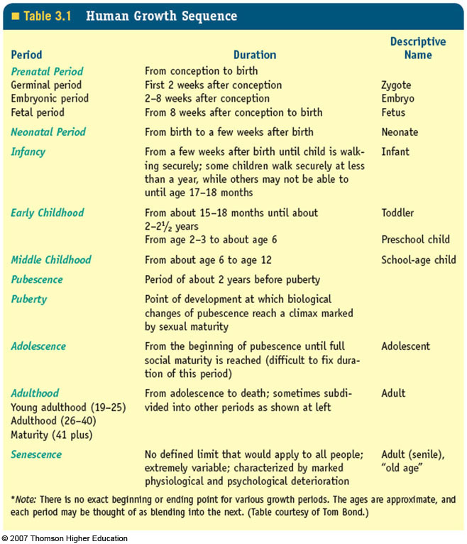

Slide 18
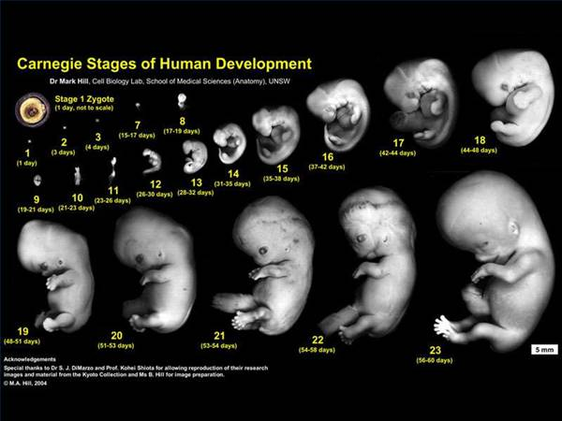
Embryo

Slide 19
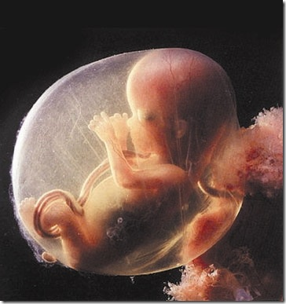
Fetus (12 weeks)

Slide 20
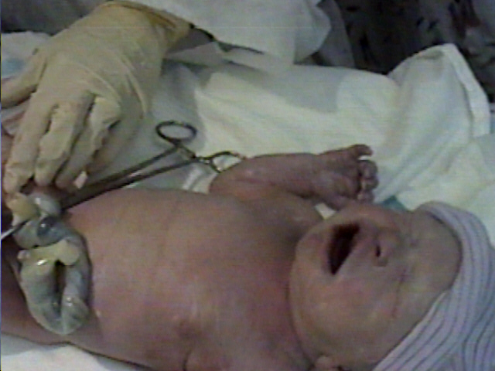
Newborn infant

Slide 21

Infant

Slide 22

Toddler

Slide 23

Preschool

Slide 24

School child

Slide 25

Preadolescent (Prepubertal)

Slide 26

Adolescent

Slide 27

Young adult

Slide 28

Mature (Older adult)

Slide 29
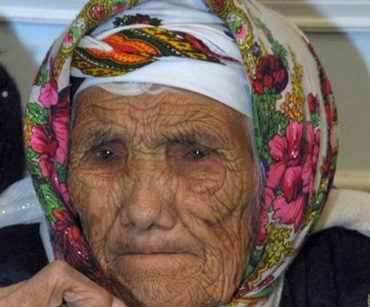
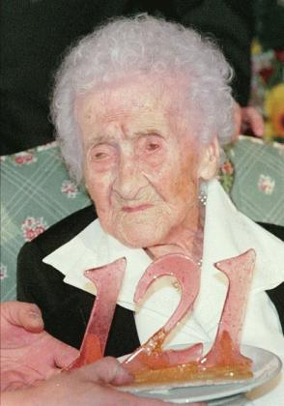
Old aged

Slide 30
Thank you
رمز الصف
cs5jm5o

